Slide 1

Sprocket Central Pty Ltd
Data analytics approach
[Division Name] - [Engagement Manager], [Senior Consultant], [Junior Consultant]

Slide 2
Agenda
Introduction
Data Exploration
Model Development
Interpretation

Slide 3
Introduction
Identify and Recommended Top 1000 Customers to target from Datasets
Outline of Problem
Sprocket Central is a company that specializes in high-quality bike and cycling accessories.
Their marketing team is looking to boost business sales by analyzing provided datasets.
Using the 3 datasets provided the aim is to analyze and recommend 1000 customers that Sprocket Central should target to drive higher value for the company
Contents of Data Analysis
‘New’ and ‘Old’ Customer age distribution
Job industry distribution
RFM Analysis and customer distribution
Number of cars owned and not owned by state
Wealth segmentation by age category
This will be done with the 3 phases of Data Exploration, Model Development, and interpretation.

Slide 4
Data Exploration
Data Quality Assessment and Clean up
Key Issues for Data Quality Assessment
Accuracy: Correct values
Currency: values up to date
Uniqueness: Records that are duplicated
Relevancy: Data items with value meta-data
Consistency: Values free from contradiction
Completeness: Data fields with values
 | Accuracy | Completeness | Consistency | Currency | Relevancy | Validity
Customer Demographic | DOB: Inaccurate Age: missing | Job title: Customer_id: incomplete | Gender: Inconsistency | Deceased customers: filled out | Default column: delete
Customer address |  | Customer_id: incomplete | States: Inconsistency
Transactions | Profit: missing | Customer_id: Incomplete Online order: blanks Brand: blanks |  |  | Cancelled status order: filter out | List price: format product sold date: format
An in-depth analysis has been sent via email.

Slide 5
Data Exploration
‘New’ and ‘Old’ Customer age distribution
Most customers are aged between 40-49 in ‘New’. In ‘Old’ majority of customers are aged between 40-49 also.
The lowest age groups are under 20 and 80+ for both ‘New’ and ‘Old’ customer lists.
The ‘New’ customer list suggests that age groups 20-29 and 40-69 are the most populated.
The ‘Old’ customer list suggests 20-69.
There is a steep drop in customers in the range 30-39 age group in ‘New’.

Slide 6
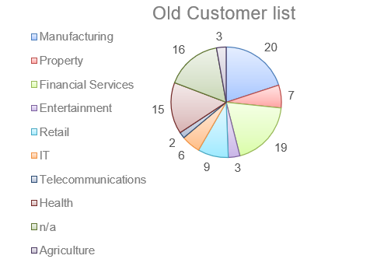
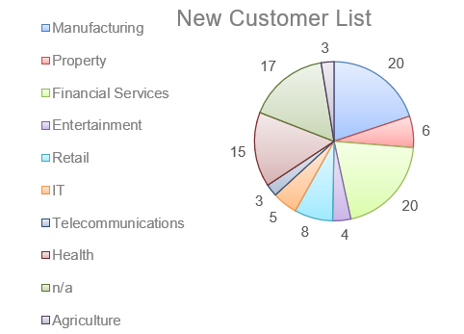
Data Exploration
Job Industry Distribution
20% of New customers are in Manufacturing and Financial Services.
The Smallest number of customers is in agriculture and Telecommunication at 3%.
Similar pattern in the ‘Old’ customer list, at 20% and 19% in manufacturing and Financial Services respectively.

Slide 7
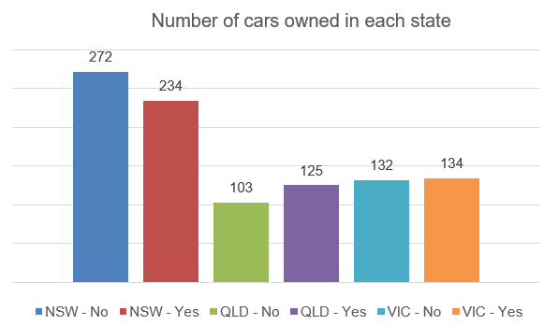
Data Exploration
Number of cars owned and not owned by state
NSW has the largest number of people that do not own a car. NSW seems to have a higher number of people from whom data was collected.
Victoria is also split quite evenly. But both numbers are significantly lower than those of NSW.
QLD has a relatively higher number of customers that own a car.

Slide 8
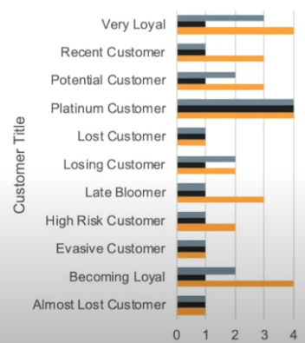

Model Development
RFM Analysis and Customer Classification
Customer titles and scores
RFM analysis is used to determine which customers a business should target to increase its revenue.
The RFM(Recency, frequency, monetary) model shows customers that have displayed high levels of engagement with the business in the 3 categories mentioned.

Slide 9
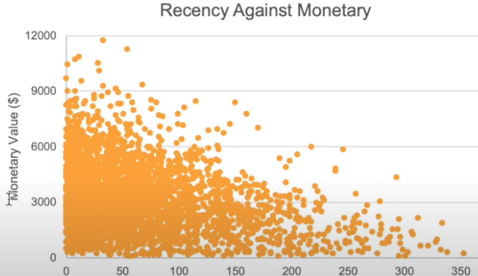
Model Development
Scatter plot based on RFM Analysis
The chart shows that customers who purchased more recently have generated more revenue, than those who visited a while ago.
Customers from the recent past (50-100 days) have also shown to generate a moderate amount of revenue.
Those who visited more than 200 days ago generate low revenue.
Recency value

Slide 10
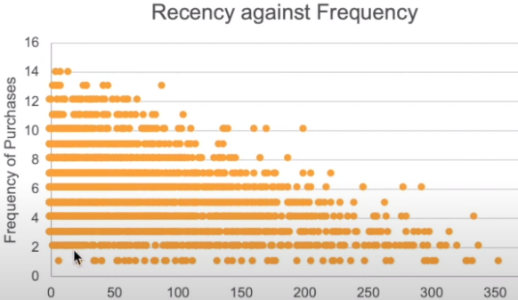
Model Development
Scatter plot based on RFM Analysis
Very low frequency of 0-2 correlated with high-frequency value i.e., more than 250 days ago.
Customers that have visited recently (0-50 days) have a higher chance of visiting more frequently (6+).
Higher frequency has a negative relationship with recency values. Such that very recent customers are also frequent customers.
Recency (days)

Slide 11
Interpretation
Summary Table of Top 1000 Customers to Target

Slide 12
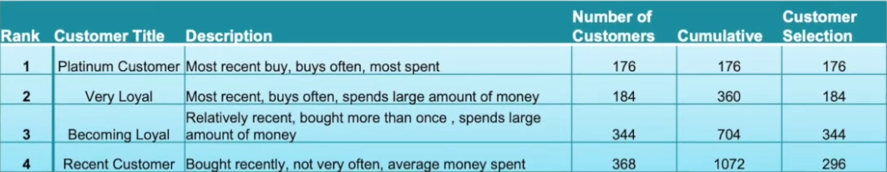
Interpretation
Customers Target and Methodology
Filter through the top 1000 customers by assigning the conditions mentioned in the table above.
The 1000 customers discovered would have bought recently, they have bought very frequently in the past and tend to spend more than other customers.

Slide 13
Appendix

